Slide 2
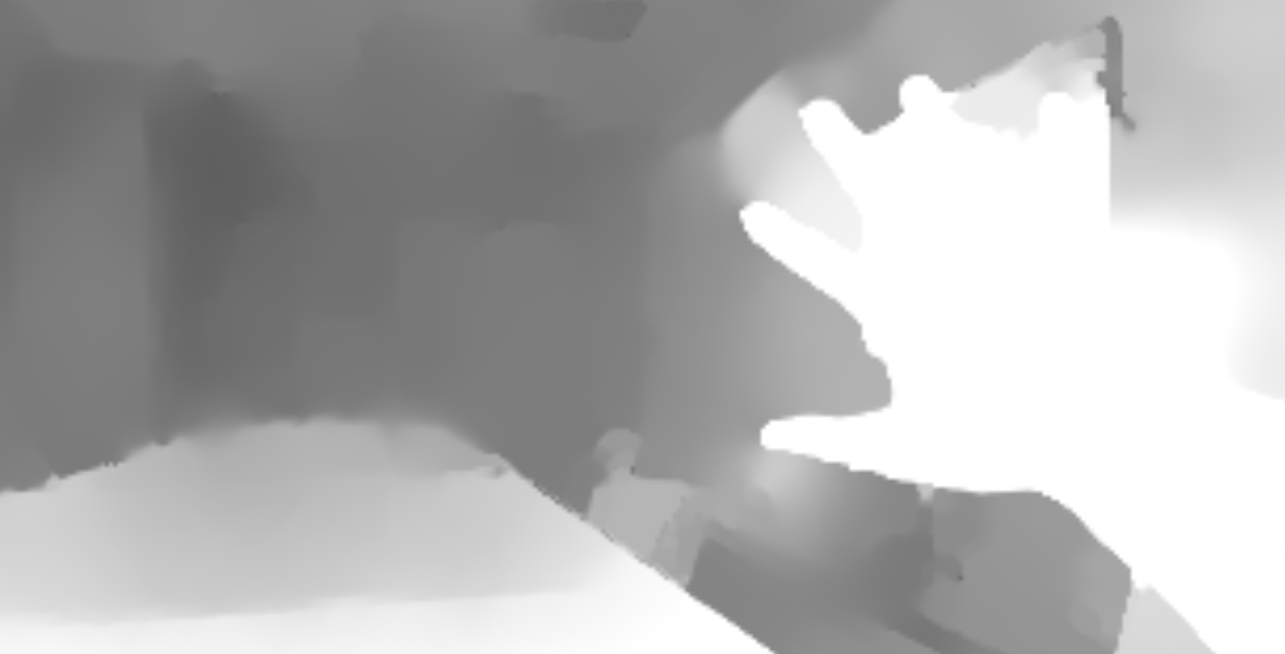
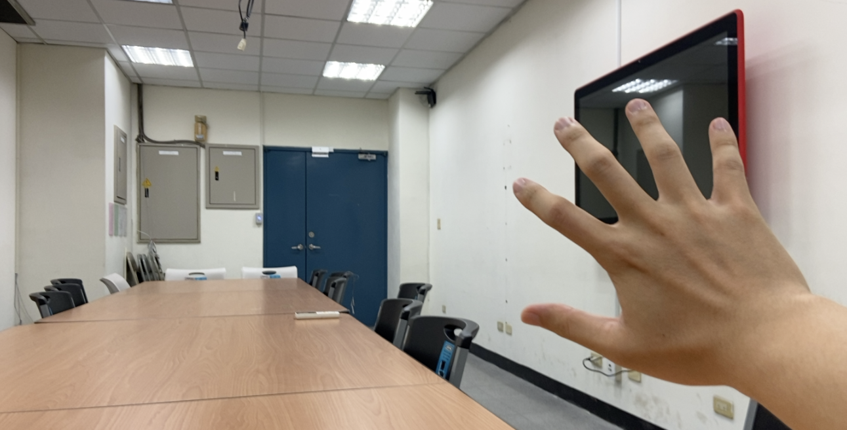
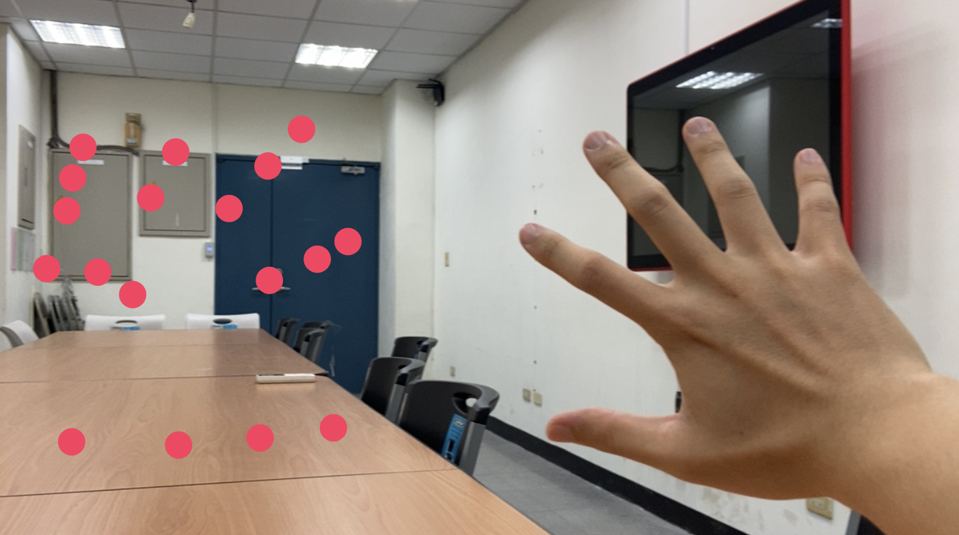
Software Ver 1: Reconstruct 3D
Dual Camera
Vision Library
AVCapturePhotoOutput
ML hand joints detector
Wide-angle image
(secondary camera)
Telephoto image
(main camera)
Disparity
2D
Hand joints result
Depth Map
AVCaptureSession
Main Tread
3D
Hand joints result
Renderer
Mirroring
Preview
Asyn Tread
UIViewController

Slide 3
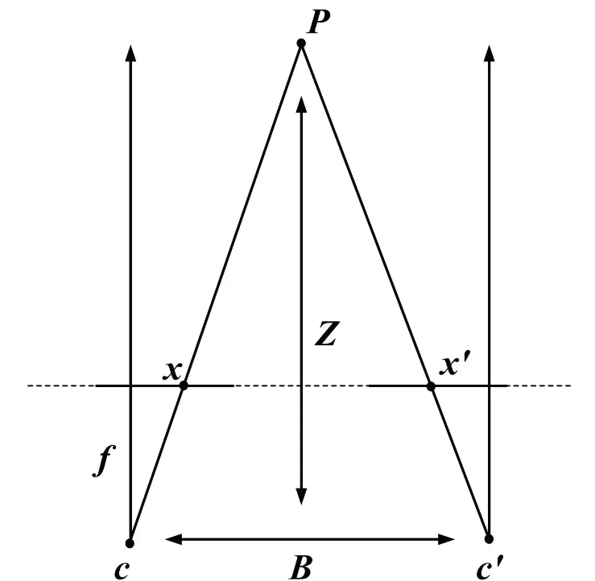
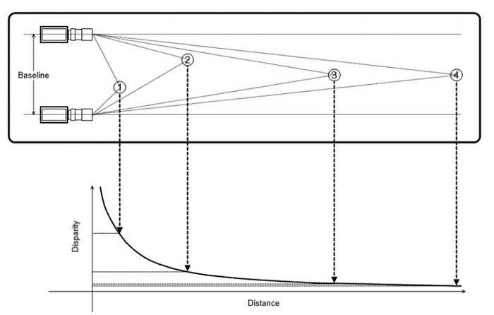
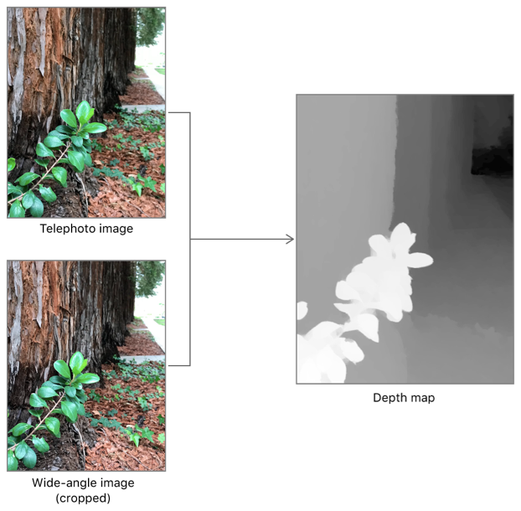
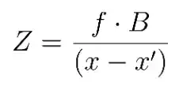
Dual camera estimate depth
EXP on iPhone 11
Output Value
9999.9f
0.2f
0.8f
“This level of accuracy indicates that values within a depth map are usable relative to one another (that is, a depth value of 2 is twice as far as a depth value of 1), but do not accurately convey real-world distance.”
Dramatically increase
Unstable increase
Linear decrees
Real Depth
0 cm
10 cm
20 cm
80 cm
Notes:
Ref:
https://www.digitalnuage.com/disparity-and-depth-estimation-from-stereo-camera
https://www.oreilly.com/library/view/learning-opencv-3/9781491937983/
https://developer.apple.com/documentation/avfoundation/avdepthdata/accuracy/relative
https://developer.apple.com/documentation/avfoundation/additional_data_capture/capturing_photos_with_depth

Slide 4
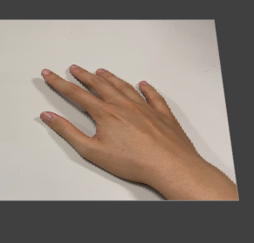

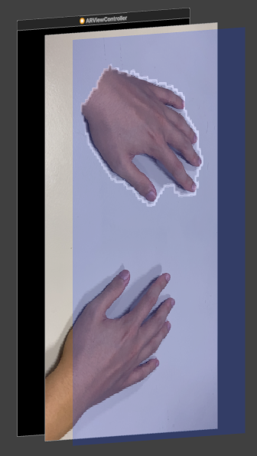
Software Ver 2: hand contour segmentation
Single Camera
CoreML Library
ARSession
ML hand contour detector
Current Frame
ARSession
Hand contour result
UIViewController
Sublayer
Transparency
Main Tread
Renderer
Masking
Rotate
(Mirroring)
Preview
Asyn Tread

Slide 5
Software Ver 3: cardboard support
Single Camera
ARConfiguration
ARSession
ML Person Segmentation
Current Frame
ARSession
Contour texture result
AppCoordinator
Rotate
(Mirroring)
Renderer
Shader
Preview
Frame buffer
Camera preview
Cardboard preview
Metal
GPU acceleration
CPU Main Tread

Slide 6




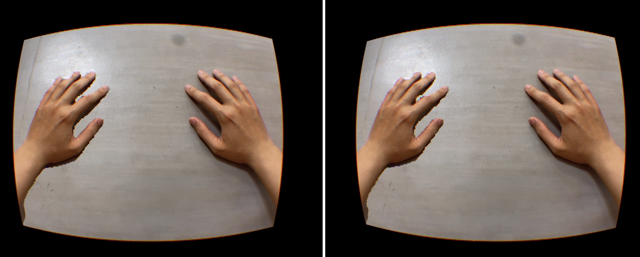
System Architecture
Subject with hemiplegia
Hardware and Accessories
ARMT system
AR tasks pipline
Frames with the human body
Human body segmentation
Performs excersice
Texture shader
iPhone iOS 15+
Frame buffer
GUI
Binocular rendering
Randerer
VR Cardboard
Real time Mirror Display

Slide 7
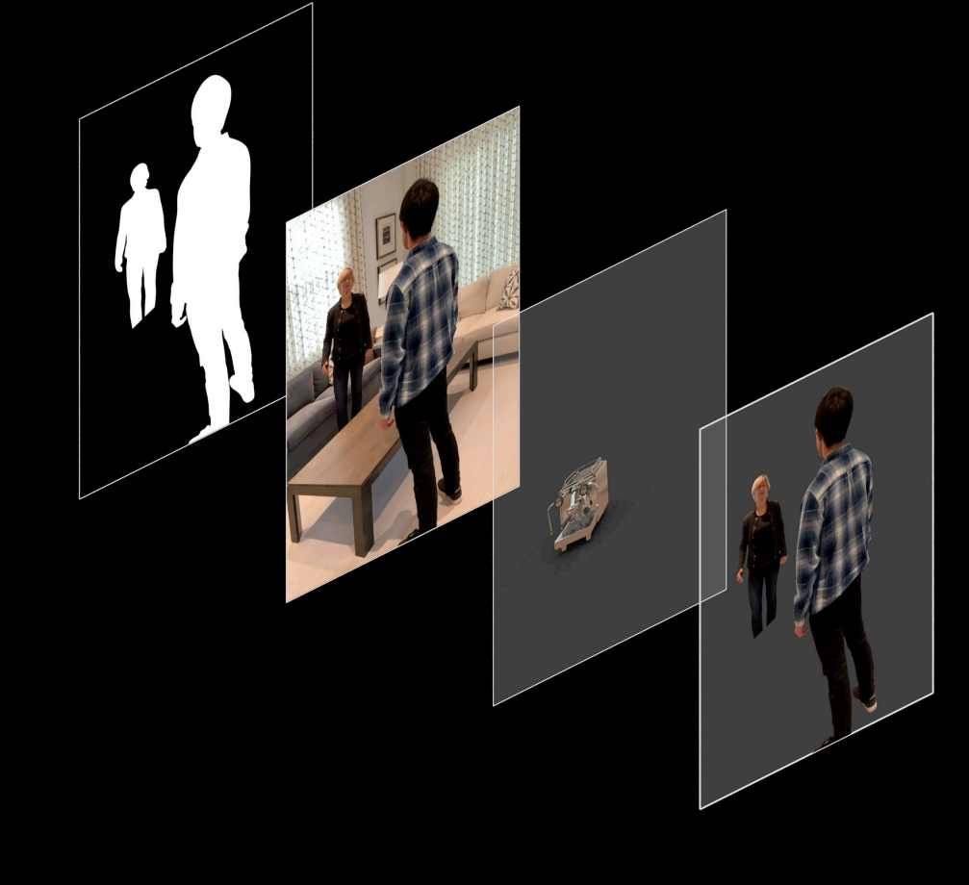
Segmentation
Camera
Rendering
People

